Slide 1
Yeast Two Hybrid System
Mrs. Aparna Patil Kose
Dept of Bioinformatics
G N Khalsa College
•
•
1

Slide 2
Outline
Definition
History
Principles
Yeast two hybrid protocol
Applications
Advantages
Disadvantages
Examples

Slide 3
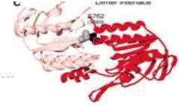
Definition
Also known as Y2H or Two-hybrid screening
molecular biology technique
Used to discover protein-protein interactions and protein–DNA interactions
testing for physical interactions (such as binding) between two proteins or a single protein and a DNA molecule, respectively.

Slide 4
History
Pioneered by Stanley Fields and Ok-Kyu Song in 1989.
originally designed to detect protein–protein
interactions using the Gal4
transcriptional
Saccharomyces
activator of the yeast
cerevisiae
The Gal4 protein activated transcription of a gene involved in galactose utilization, which formed the basis of selection.

Slide 5
Cont ..
Since then, the
same
principle many
has been
adapted methods,
including
to describe
alternative
some that detect protein–DNA
interactions or DNA-DNA interactions, as well
as methods that use different host
or
organisms such as Escherichia coli
mammalian cells instead of yeast.

Slide 6
PRINCIPLES
Y2H assay relies on the expression of a reporter gene (such as lacZ or GFP), which is activated by the binding of a particular transcription factor.
The transcription factor is composed of a DNA- binding domain (BD) and an activation domain (AD).
The query protein of interest fused with the BD is known as the Bait, and the protein library fused with the AD is referred to as the Prey.

Slide 7
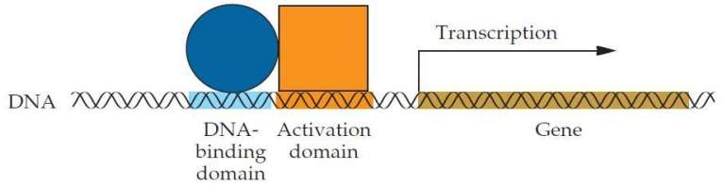
Cont….
4.
In order
to activate the reporter
gene
expression,
a transcriptional unit
must
be
present at the gene locus, which
is only
possible if Bait and Prey interact.

Slide 8
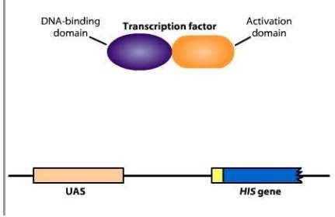
Yeast two hybrid protocol
The early yeast two hybrid systems were based on the finding that many eukaryotic transcription factors Have seperable DNA binding transcriptional activator domains

Slide 9
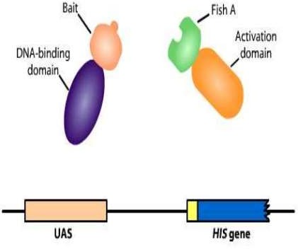
The protein of interest, the “bait”, is fused to a DNA- binding domain.
Proteins that bind to bait, the “fish” or “prey”, are fused to a transcription activation domain.

Slide 10
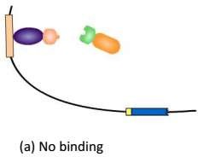
Proteins that do not bind to the bait will not activate the transcription of the reporter gene (HIS in this case)

Slide 11
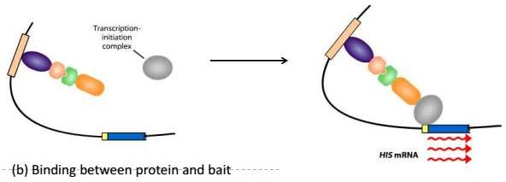
Any protein that binds to the bait will activate the transcription of the reporter gene.

Slide 12
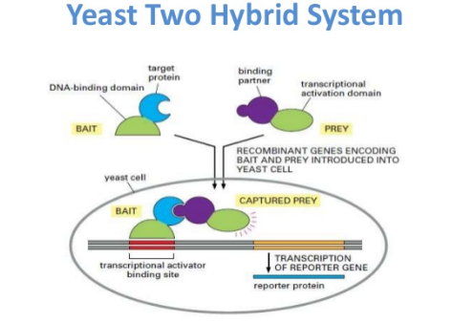

Slide 13
Applications
Determination of sequences crucial for interaction
Drug and poison discovery
Identifies novel protein-protein interactions
Can identify protein cascades
Identifies mutations that affect protein- protein binding
Can identify interfering proteins in known interactions (Reverse Two Hybrid System)

Slide 14
Advantages
Immediate availability of the cloned gene of the interacting protein.
Only a single plasmid construction is required
Interactions are detected in vivo.
Weak, transient interactions can be detected
Can accumulate a weak signal over time
Protein purification not necessary
No antibodies requires

Slide 15
Disadvantages
False positives are the largest problem with the yeast two-hybrid system.
Possible incorrect protein folding in yeast
gene encoding target protein must be available
failed to detect some know interactions
Fusion proteins may inhibit the original interaction.

Slide 16
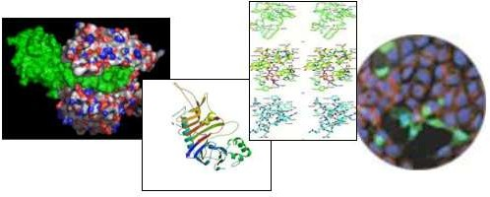
Examples of Uses of the Yeast Two- Hybrid System
Identification of caspase substrates
Interaction of Calmodulin and L-Isoaspartyl Methyltransferase
Genetic characterization of mutations in E2F1
Peptide hormone-receptor interactions

Slide 17
References
Y2H: https://youtu.be/2p6G3yA-hO4
The yeast two-hybrid system for studying protein-protein interactions ;Jeremy Luban and Stephen P Goff ;Columbia University and Howard Hughes Medical Institute, New York, USA

